Slide 1
Paychex Azure Journey
Application migration into Azure
Evolution from Azure classic to ARM
Rochester Azure User’s Group
August 2019

Slide 2
Agenda
Overview and Context
Application architecture
Lift and Shift to Azure ‘classic’
Migration to Azure ARM
Successes and Challenges
What’s next
Q&A
Place your screenshot here

Slide 3
Overview
Started with an established application suite
Suite of 6 applications and services
3 web sites – ASP.NET MVC web and mobile web
3 web services – ASP.NET WebAPI and WCF/SOAP services
Hosted on-premises – IIS Web Server farm & SQL Server
Lift and Shift migration to Azure
Azure ‘classic’ Cloud Services compute
Azure SQL Database, eventually including Elastic Pools
Operational components and supporting infrastructure
Migration to Azure ARM
Azure App Service PaaS compute
Azure Application Gateway routing layer
Operational and infrastructure updates
Notes:
Using PaaS services for cloud value prop – offload operational ownership and effort

Slide 4
Context
Present Azure architecture and services used in our solution approaches
Cover solution composition and evolution of Azure services
Representative application architecture for .NET Web Apps and Services
Focus more on Azure, less on application minutiae

Slide 5
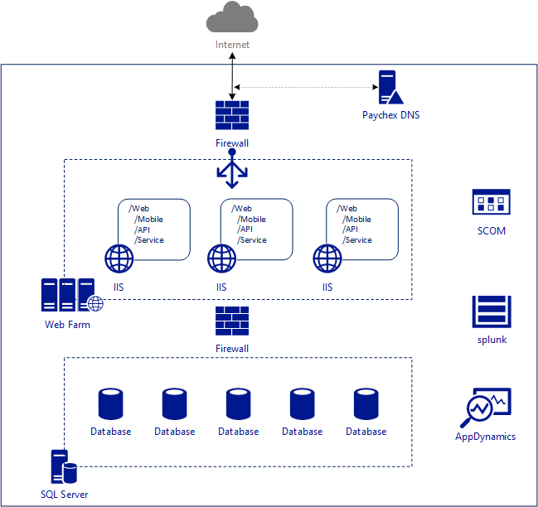
On-premises topology
Web tier – IIS web farm
.NET Framework v4.x
ASP.NET MVC
Data tier – SQL Server
Dedicated VMs
Data center infrastructure
DNS, Network zones, etc.
Operational tools

Slide 6
Business Case for Azure
Application
Time and Attendance focus
24/7 client engagement
Daily variation in usage patterns
Significant regular traffic spikes
Typical ASP.NET design and stack
ASP.NET MVC apps
Web API and WCF services
SQL Server data tier
Infrastructure
Traffic spikes drive need for rapid scaling
Daily variation in resource usage drives need to optimize performance and cost tradeoffs
Client growth drives ongoing need for capacity allocation
Generally, take advantage of cloud elasticity

Slide 7
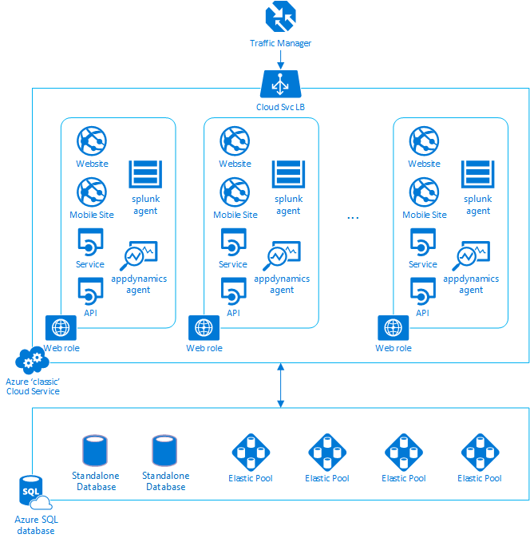
Azure Classic
Azure Traffic Manager
DNS for Paychex custom domain in Azure
Azure ‘classic’ Cloud Service
Web roles
Multiple apps per role instance
Software agents
Splunk logging
AppDynamics
Azure SQL Database
Mix of standalone and pooled databases

Slide 8
Azure classic architecture challenges
Lack of runtime isolation
Uptime and application resiliency
Apps can impair other apps
Failure mode permutations
Resource competition
Apps compete for resources (CPU, I/O bandwidth, etc.)
Compounding resource usage during traffic spikes
Troubleshooting
Basic log analysis made difficult
Defect isolation and reproducibility challenges
Cloud service learning curve
Monolithic deployments
Heavy weight deploys and scaling operations
Limited node health visibility
Mix of varying workload resource needs and traffic profiles
Workload imbalance from simplistic load balancing
Utility model
Opaque runtime limits
Unpredictable application failure modes
Immature operational controls

Slide 9
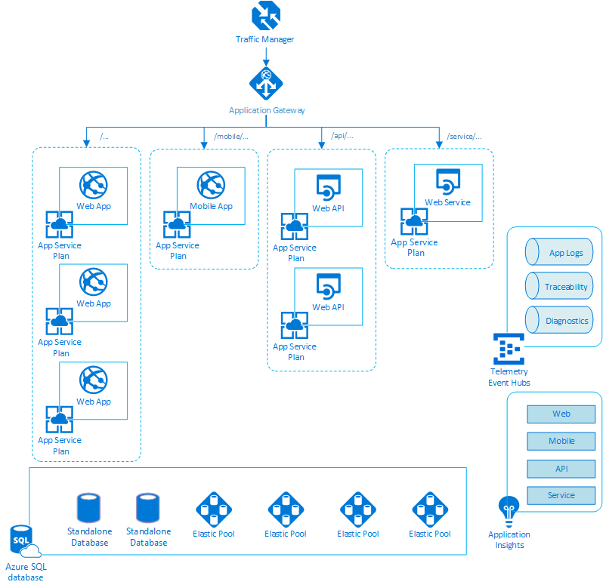
Azure ARM
Azure Application Gateway
Application delivery controller
Path based routing
Load balance across App Service Plans
Azure App Service
Application compute runtime
Evolved PaaS model service
Event Hubs
Telemetry backbone
Logs and diagnostics offload
Application Insights
Detailed app execution and health
Tight integration with Azure services
Notes:
Greg: add color on how App GW made cut over easier

Slide 10
Azure ARM architecture – getting there
Game plan
Introduce App GW as routing layer
Migrate apps one at a time
Learn on less intensive workloads
Build out operational capabilities
Build out CI/CD pipelines
Rinse and repeat
Keep the ‘classic’ lights on until we’re done
ARM lessons learned
App Gateway
Path matching != URL rewriting
Request header munging
App Service incompatibilities
App Service
Service tiers and scale out
App or sub app?
Fast scaling, but not that fast!
ARM templates and other arcana
How to start and iterate ARM templates?
Resources, resource groups, and deployments
Stupid PowerShell tricks
CI/CD pipeline proliferation
Notes:
Greg: talk to scaling findings and current approach

Slide 11
Azure ARM architecture - successes and challenges
Successes
Workload isolation
Independent deployment
Independent scale
Per app resource capacity
ARM service stability
Application Gateway performance
Once deployed, apps tend to stick
ARM service continuous improvements
App Gateway auto scale
App Services VNET integration
Cloud value proposition
Easier elasticity on a per-workload basis
Clearer cost vs. value for each workload
Challenges
Workload isolation
Uncovers hidden cross app dependencies
Calls for per app redundancies for resiliency
Operational isolation
Uncovers errors that we couldn’t see before
Calls for more consistency across apps
ARM services
Less forgiving of obscure code and config
Challenges integrating hybrid services
DevOps culture
Infrastructure is abstract (no VMs, no RDP, …)
Pets vs. cattle
Notes:
Greg/Carl: talk about App Services and VNETs

Slide 12
What’s next?
ARM migration completion
Internal service integration
App Service Regional VNET integration
Maybe Microsoft peering, instead
Mutual TLS
App Gateway uplift
App Gateway SKU upgrade
Take advantage of auto scale
Other feature improvements
Azure ops formalization
Monitoring and alerting
Scaling and capacity automation
Future Azure engagements
Active-active in multiple Azure regions
Database latency concern
Azure front door?
Minimize regional failure impact
Azure API Management
Unification of API backends
Standardized authentication and authorization
Other cross-cutting concerns
Containerized services
AKS or Azure OpenShift service
API ingress
Service mesh

Slide 13
Q & A

Slide 14
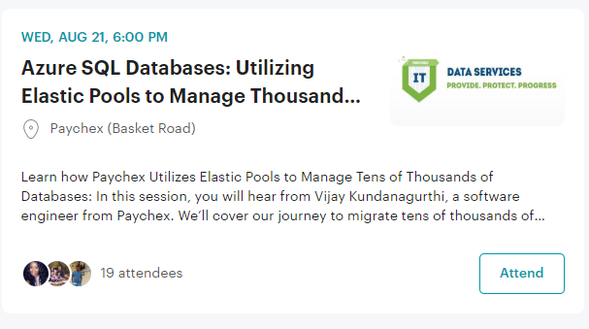
Join us for the next Rochester Infrastructure Group meetup…
https://www.meetup.com/RIG-Rochester-Infrastructure-Group

